Slide 1
METHANOL
Dr.Ali Ostadi Associate Professor of Forensic Medicine and Toxicology Fellowship of clinical toxicology &poisoning Department of Internal Medicine Tabriz University of Medical Sciences

Slide 2
HISTORY AND EPIDEMIOLOGY
Methanol was a component of the embalming fluid used in ancient Egypt.
Robert Boyle first isolated the molecule in 1661 by distilling boxwood, calling it spirit of box.
Methanol is also used as a solvent by itself or as an adulterant in “denatured” alcohol.
In a Turkish series, cologne was also most common, accounting for almost 75% of ingestions.

Slide 3
CHEMISTRY
Alcohols are hydrocarbons that contain a hydroxyl (–OH) group. The term “toxic alcohol” refers to alcohols other than ethanol that are not intended for ingestion.
In a sense, this is arbitrary, since all alcohols are toxic, causing inebriation and end-organ effects if taken in excess.
The most common clinically relevant toxic alcohols are methanol and ethylene glycol .

Slide 4
TOXICOKINETICS/TOXICODYNAMICS Absorption Ingestion
Alcohols are rapidly absorbed after ingestion but are not completely bioavailable because of metabolism by gastric alcohol dehydrogenase (ADH), as well as by first-pass hepatic metabolism.

Slide 5
Inhalation
Although methanol is absorbed in significant amounts by inhalation, poisoning by this route is uncommon.
In workers exposed to methanol fumes from industrial processes for up to 6 hours at concentrations of 200 ppm there was no significant accumulation of methanol or its metabolite formate.

Slide 6
Transdermal
Most alcohols have some dermal absorption, although isopropanol and methanol penetrate the skin much more effectively than ethylene glycol.
Most reported cases of toxic alcohol poisoning by this route involve infants.
When transdermal methanol exposure is prolonged, severe toxicity is reported.

Slide 7
Distribution
Once absorbed, alcohols are rapidly distributed to total body water.
In human volunteers given an oral dose of methanol on an empty stomach, the measured volume of distribution was 0.77 L/kg, with a distribution half-life of about 8 minutes.

Slide 8
Metabolism and Elimination
Without intervention, toxic alcohols are metabolized through successive oxidation by ADH and aldehyde dehydrogenase (ALDH), each of which is coupled to the reduction of NAD+ to NADH.
Methanol is metabolized to formaldehyde, then to formic acid .
The formate metabolite is then bound by tetrahydrofolate and undergoes metabolism by 10-formyltetrahydrofolate dehydrogenase to carbon dioxide and water.

Slide 9
Methanol is also eliminated from the body as unchanged parent compounds.
Methanol does not have significant renal elimination (about 1% of the ingested dose in patients with intact hepatic metabolism) and is cleared much more slowly than is ethylene glycol, presumably as a vapor in expired air (half-life 52 hours, with a longer half-life at very high concentrations).

Slide 10
Alcohols: R-OH
OH
H
H
H-C-H
H-C-OH
H-C-OH
H-C-H
H-C-OH
H
H
H
Methanol
1C
Ethanol
2C
Ethylene Glycol
2C

Slide 11
Ethanol
OH
O
O
H-C-H
ADH
C-H
ALDH
C-OH
H-C-H
H-C-H
H-C-H
H
H
H
Ethanol
Acetaldehyde
Acetic Acid
ADH = Alcohol Dehydrogenase
ALDH = Aldehyde Dehydrogenase

Slide 12
Methanol
Molecular weight 32
Low freezing point
Highly volatility
H
H-C-OH
H
Methanol

Slide 13
Methanol Metabolism
H
O
O
ADH
ALDH
H-C-OH
H-C-H
H-C-OH
H
H
H
Methanol
Formaldehyde
Formic Acid
ADH: Alcohol Dehydrogenase
ALDH: Aldehyde Dehydrogenase

Slide 14
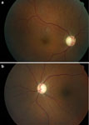
Methanol Toxicity
Delayed onset (8-12hrs)
Anion gap acidosis
Tachypnea
Visual complaints
Retinal metabolism
“Snow storm”
Notes:
Optic atrophy with cupping 2 months after surviving
Pt with non-reactive pupils and min light perception

Slide 15
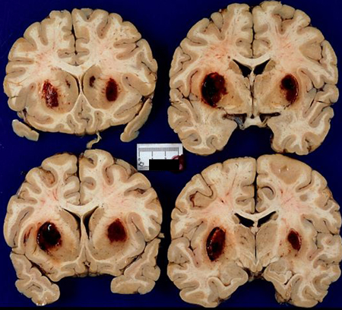
Methanol Toxicity
CNS depression
Bilateral hemmorhage putamen
Abdominal pain
Multisystem organ failure
University of Western Ontario:
Neurology Collection

Slide 16
PATHOPHYSIOLOGY AND CLINICAL MANIFESTATIONS Acute Central Nervous System Effects
All alcohols cause inebriation, depending on the dose.
Additionally, serum methanol concentrations of 25 to 50 mg/dL are associated with toxicity, whereas one may legally drive a car in the US with a blood ethanol concentration of up to 80 mg/dL.

Slide 17
Clinical Manifestations and Pathophysiology Central Nervous System Effects All alcohols may cause inebriation, depending on the dose isopropanol > ethylene glycol > ethanol > methanol

Slide 18
Metabolic Acidosis Metabolic acidosis with an elevated anion gap is a hallmark of toxic alcohol poisoning

Slide 19
Specific End-Organ Effects Methanol causes visual impairment ranging from blurry or hazy vision or defects in color vision, to snowfield vision or total blindness in severe poisoning

Slide 20
The formate metabolite of methanol is a mitochondrial toxin, inhibiting cytochrome oxidase (much like cyanide) and thereby interfering with oxidative phosphorylation

Slide 21
Diagnostic Testing Toxic Alcohol Concentrations methanol level greater than 25 mg/dL has been considered toxic

Slide 22
Anion Gap and Osmol Gap hallmark of toxic alcohol poisoning osmol gap -14 to +10, patients who present early after ingestion may have a high osmol gap and normal anion gap, whereas those who present later may have the reverse

Slide 23
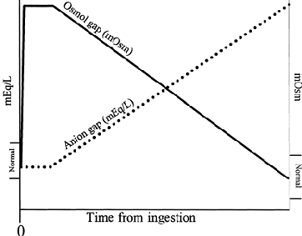

Slide 24
Treatment
Methanol
Ethanol
Ethylene Glycol
ADH
ALDH
Aldehyde
Acid

Slide 25
Management Alcohol Dehydrogenase Inhibition affinity for ethanol that is 15 times greater in vitro than its affinity for methanol, on a molar basis

Slide 26
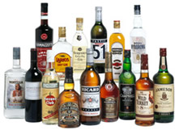
Ethanol Infusion: Management
Serial ethanol levels
Watch glucose and sodium
Observe for respiratory status

Slide 27
Ethanol 0.8 g/kg of ethanol is given orally over 20 minutes 100-154 mg/kg/h hemodialysis (250-350 mg/kg/h)

Slide 29
PHARMACOKINETICS/TOXICOKINETICS
Ethanol is rapidly absorbed from the gastrointestinal (GI) tract,
with approximately 20% absorbed from the stomach and the remainder from the small intestine.
Factors that enhance absorption include rapid gastric emptying, ethanol intake without food, the absence of congeners, dilution of ethanol (maximum absorption occurs at a concentration of 20%), and carbonation.
Under optimal conditions for absorption, 80% to 90% of an ingested dose is fully absorbed within 60 minutes.
Ethanol is primarily eliminated by the liver, with 2% to 5% excreted unchanged by the kidneys, lungs, and sweat.

Slide 30
As the system is saturated, ethanol elimination changes from first-order to zero-order kinetics.
In adults, the average rate of ethanol metabolism is 100 to 125 mg/kg/h in occasional drinkers and up to 175 mg/kg/h in habitual drinkers.
As a result, the average-sized adult metabolizes 7 to 10 g/h and the blood ethanol concentration falls 15 to 20 mg/dL/h (3.26–4.35 mmol/L/h)Tolerant drinkers, by recruiting CYP2E1, may increase their clearance of ethanol to 30 mg/dL/h (6.5 mmol/L/h) or even higher.

Slide 31
XENOBIOTIC INTERACTIONS
Ethanol interacts with a variety of xenobiotics
The most frequent ethanol–drug interactions occur as a result of ethanol-induced increase in hepatic xenobiotic-metabolizing enzyme activity.
The interaction between ethanol and disulfiram (Antabuse) is well described, and it can be life threatening .

Slide 32
Fomepizole
A blocker of alcohol dehydrogenase
Has replaced ethanol as the agent of choice in known or suspected exposures
Minimal adverse effects
Notes:
Advantage: pediatrics where one sip of 100% methanol can be toxic
Can initatiate therapy and wait for level

Slide 33
Fomepizole The dose of fomepizole is 15 mg/kg intravenously as an initial loading dose followed by 10 mg/kg every 12 hours. After 48 hours of therapy, fomepizole induces its own metabolism, so the dose must be increased to 15 mg/kg every 12 hours

Slide 34
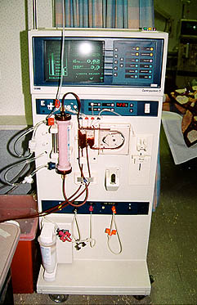
Hemodialysis

Slide 35
Adjunctive Therapy Folate and leucovorin enhance the clearance of formate

Slide 36
Leucovorin (Folinic Acid) and Folic Acid 1-2 mg/kg every 4-6 hours

